Slide 1
Overview of data types, variables and objects in Java

Slide 2
Data Types
Java is a strongly typed language i.e. every variable must have a declared type
there are 8 primitive types:
4 of them are integer:
2 are floating-point
one is character type char
one is boolean type for logical values
Notes:
integer – int (4 bytes), byte, short, long
floating-point – double, float

Slide 3
Primitive Types
Integers
int type is most practical - uses 4 bytes of storage
use long for larger numbers - uses 8 bytes
Floating-Point types
use double for most applications - float is limited to seven (approx) significant digits

Slide 4
Character types
single quotes are used to denote char constants e.g. ‘H’ is a character, it is different from “H”, a string containing a single character
Unicode encoding scheme is used - a 2-byte code
this allows 65,536 characters - ASCII is a subset

Slide 5
Boolean type
boolean type has two values, false and true

Slide 6
Other types
all other types (including array) in Java are objects
e.g. String greeting = new String(“Hello”);
or String greeting = “Hello”;
the variable name i.e. greeting, represents a reference to the object

Slide 7
greeting (a reference) is on the stack
The object is on the heap
The stack contains temporary data such as method parameters, return addresses and local variables for each method
The heap is memory that is dynamically allocated during run time
In TIJ3, see Object Creation, Use and Lifetimes – Chapter 1. Introduction to Objects

Slide 8
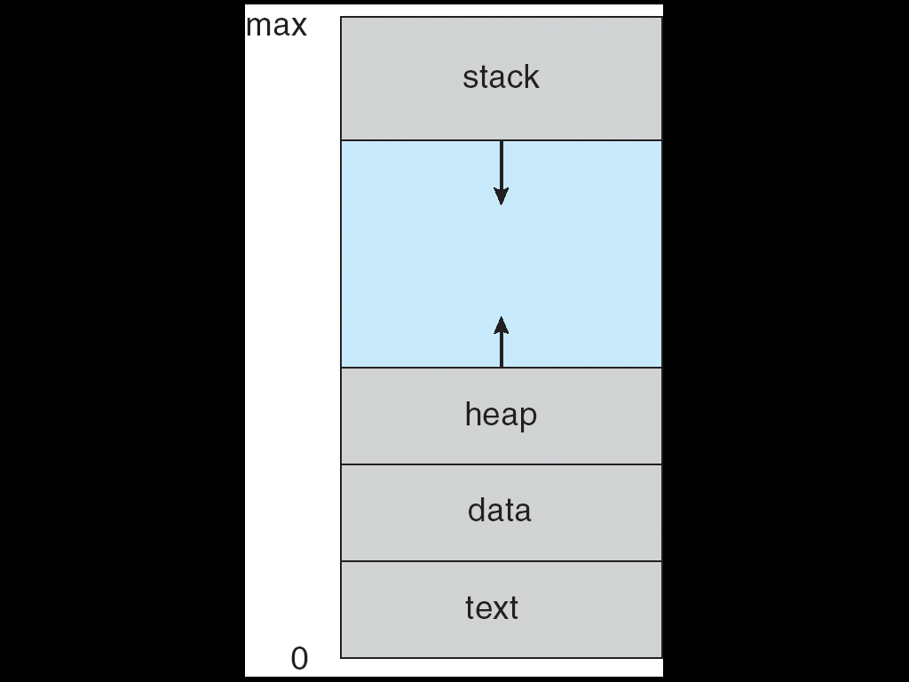
A program (process) in memory

Slide 9
Stack Heap
greeting
String
“Hello”

Slide 10
can set a variable to refer to an existing object:
String greeting1 = greeting;
Both now refer to the same object:
Notes:
Consider the difference between an object variable and a variable storing a primitive value. A primitive variable actually stores the value, not a reference to the value
Thus
int num1 = 10;
int num2 = num1;
num1 = 12;
What values do num1 and num2 have now?

Slide 11
Stack Heap
greeting
greeting1
String
“Hello”
11
Notes:
11

Slide 12
can set an object variable to null
greeting = null;
greeting then refers to no object
so cannot apply a method to the variable:
String greetingUpperCase = greeting.toUpperCase(); // runtime error
What error will you get?

Slide 13
greeting1 will still reference the String object
Stack Heap
greeting
greeting1
null
String
“Hello”

Slide 14
greeting1 = null;
Stack Heap
greeting
greeting1
null
String
“Hello”
null

Slide 15
Object Destruction
The String has now no references to it
What will happen to it?
Java does automatic garbage collection
thus a destructor is not required to reclaim memory set aside for an object no longer in use

Slide 16
Arrays
an array declaration:
double [] values;
an array is an object, therefore:
to instantiate an array, must use new operator:
values = new double[10];
or can do both in one statement:
double [] values = new double[100];

Slide 17
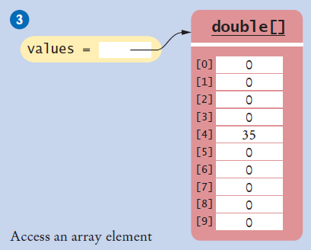
double values[];
values = new double[10];
values[4] = 35;

Slide 18
to find the number of elements in an array, use arrayName.length
e.g.
for (int i = 0; i < values.length; i++)
System.out.println(values[i]);
can supply initial values :
int [] smallPrimes = {2, 3, 5, 7, 11, 13};
18
Notes:
18

Slide 19
Note : elements of an array are directly accessible
the position of each element can be computed from its index by a mathematical formula
For example, an array of 10 integer variables, with indices 0 through 9, may be stored at memory addresses 2000, 2001, 2002, … 2009, so that the element with index i has the address 2000 + i

Slide 20
Array of objects
String[] names = new String[10];
names[0] = new String(“Bob”);

Slide 21
Stack Heap
names
String
“Bob”

Slide 22
See also http://stackoverflow.com/questions/7015683/where-is-array-saved-in-memory-in-java

